Slide 1


MALLA REDDY COLLEGE OF ENGINEERING & TECHNOLOGY (AUTONOMUS INSTITUTION –UGC, GOVT. OF INDIA) Affiliated to JNTUH; Approved by AICTE, NBA-Tier 1 & NAAC with A-GRADE| ISO 9001:2015
“FractoScan – Automated Detection and Classification of Orthopedic Fractures Using Convolutional Neural Networks (CNNs)”
Team Members Details
1. G. Amulya - 23N31A6695
2. G. Abhinav - 23N31A66B0
3. K. Yogendra Balaji - 23N31A66C8
III Year B. Tech-I Semester – CSE (AIML)
Under the Guidance of
Mr.MOHAMMAD AZHAR
Assistant Professor
B. Tech III Year – I Sem | Dept of Computational Intelligence| Application Development – 1 | Project Review

Slide 2

Agenda
MALLA REDDY COLLEGE OF ENGINEERING AND TECHNOLOGY
1. Abstract
2. Introduction
3. Existing System
4.Drawbacks of Existing System
5. Proposed System
6.Advantages of Proposed System
7. S/W and H/W Requirements
8. UML Diagrams
9. Conclusion
10. Future Enhancements
B. Tech III Year – I Sem | Dept of Computational Intelligence| Application Development - 1 | Project Review

Slide 3
MALLA REDDY COLLEGE OF ENGINEERING AND TECHNOLOGY
Abstract
Bone fracture detection is a crucial task in orthopedics, where early and accurate diagnosis helps ensure effective treatment. This project, FractoScan, introduces an automated system for detecting and classifying fractures using Convolutional Neural Networks (CNNs) trained on the MURA dataset, which includes seven bone types: finger, elbow, hand, forearm, humerus, wrist, and shoulder. The workflow begins with preprocessing techniques such as resizing, normalization, and augmentation to improve data quality and robustness. CNNs are then applied to automatically learn spatial and structural features from X-ray images without the need for manual feature extraction. The system not only classifies fracture types but also provides fracture severity estimation, automated medical report generation, and treatment suggestions, making it a valuable decision-support tool for radiologists and orthopedic doctors. By leveraging CNNs, FractoScan achieves high accuracy, efficiency, and scalability, offering a reliable and user-friendly approach to fracture analysis and diagnosis.
B. Tech III Year – I Sem | Dept of Computational Intelligence| Application Development – 1 | Project Review

Slide 4
Introduction:
MALLA REDDY COLLEGE OF ENGINEERING AND TECHNOLOGY
The project detects and classifies bone fractures from X-ray images.
It uses Convolutional Neural Networks (CNNs) trained on the MURA dataset (7 bone types).
Preprocessing improves image quality before training.
CNN automatically learns features → no manual work needed.
The system provides:
Fracture severity estimation
Grad-CAM visualization (highlights fracture areas)
Automated reports and treatment suggestions
Makes diagnosis faster, accurate, and helpful for doctors.
B. Tech III Year – I Sem | Dept of Computational Intelligence| Application Development - 1 | Project Review

Slide 5
Existing System
MALLA REDDY COLLEGE OF ENGINEERING AND TECHNOLOGY
Manual Diagnosis
Doctors visually check X-rays → slow, subjective, and error-prone.
Early Machine Learning Models
Used SVM, k-NN, Naive Bayes.
Needed manual feature extraction (shapes, edges).
Could not handle complex fracture patterns.
CNN Research Models
Existing CNNs give good accuracy.
But focus only on classification.
No support for severity estimation, visualization, or treatment suggestions.
B. Tech III Year – I Sem | Dept of Computational Intelligence| Application Development – 1 | Project Review

Slide 6
Drawbacks of Existing System
MALLA REDDY COLLEGE OF ENGINEERING AND TECHNOLOGY
Manual diagnosis is time-consuming and error-prone.
Accuracy depends on the doctor’s experience.
Early ML models need manual feature extraction.
Existing CNNs focus only on classification.
No features like fracture severity, visualization (Grad-CAM), or treatment guidance.
Deep learning models need large datasets and high computing power.
B. Tech III Year – I Sem | Dept of Computational Intelligence| Application Development – 1 | Project Review

Slide 7
Proposed System
MALLA REDDY COLLEGE OF ENGINEERING AND TECHNOLOGY
An automated system for bone fracture detection and classification.
A dataset splitting process for training and validation.
Preprocessing methods to improve image quality.
A trained model for classifying X-ray images.
Visualization of results using heatmaps to highlight fracture areas.
A user interface for uploading X-rays and viewing predictions.
B. Tech III Year – I Sem | Dept of Computational Intelligence| Application Development – 1 | Project Review

Slide 8
Advantages of Proposed System:
MALLA REDDY COLLEGE OF ENGINEERING AND TECHNOLOGY
Provides automated fracture detection and classification, reducing manual effort.
Ensures faster and more accurate diagnosis compared to traditional methods.
3.Preprocessing improves image quality, leading to better results.
4.Visual heatmaps make predictions more understandable and transparent.
B. Tech III Year – I Sem | Dept of Computational Intelligence| Application Development – 1 | Project Review

Slide 9
Software Requirement Specifications
MALLA REDDY COLLEGE OF ENGINEERING AND TECHNOLOGY
Operating System: Windows 11
Programming Language: Python 3.7+
Libraries: Streamlit,Tensorflow,Opencv-python,Numpy,Pandas,Scikit-learn,Matplotlib
Integrated Development Environment: Jupyter Notebook, VS Code 1.103 version.
B. Tech III Year – I Sem | Dept of Computational Intelligence| Application Development – 1 | Project Review

Slide 10
Hardware Requirement Specifications
MALLA REDDY COLLEGE OF ENGINEERING AND TECHNOLOGY
Processor: Intel Core i5/i7 (Quad-Core, 2.4 GHz )
RAM: 16 GB DDR
Storage: 256 GB SSD
GPU: NVIDIA GPU with CUDA support
B. Tech III Year – I Sem | Dept of Computational Intelligence| Application Development – 1 | Project Review

Slide 11
Algorithm:
MALLA REDDY COLLEGE OF ENGINEERING AND TECHNOLOGY
Dataset Preparation
Collect X-ray images (MURA dataset).
Apply preprocessing (resize, normalize, augment).
Model Development & Training
Design CNN architecture.
Train and validate model for fracture detection.
Prediction & Classification
Input X-ray → Model predicts fracture type/severity.
Visualization & Reporting
Grad-CAM highlights affected regions.
Automated diagnostic report is generated.
Deployment & Usage
Streamlit interface allows X-ray upload.
Doctors receive instant results with visual explanations.
B. Tech III Year – I Sem | Dept of Computational Intelligence| Application Development – 1 | Project Review

Slide 12
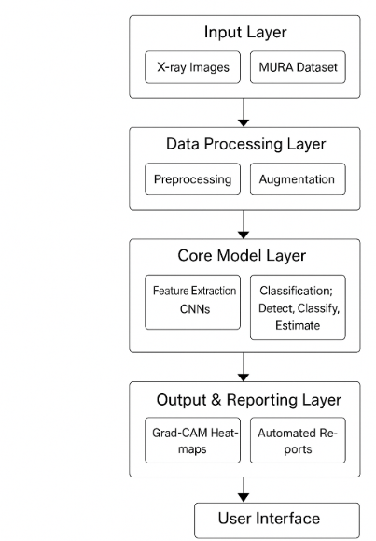
System Architecture
MALLA REDDY COLLEGE OF ENGINEERING AND TECHNOLOGY
B. Tech III Year – I Sem | Dept of Computational Intelligence| Application Development – 1 | Project Review

Slide 13
MALLA REDDY COLLEGE OF ENGINEERING AND TECHNOLOGY
Input Layer: Receives X-ray images from the MURA dataset as input for analysis.
Data Processing Layer: Applies preprocessing (resizing, normalization, noise removal) and augmentation to improve image quality and model robustness.
Core Model Layer: CNN extracts features, detects fractures, identifies bone type, and estimates severity.
Output & Reporting Layer: Generates Grad-CAM heatmaps for visualization and automated diagnostic reports for easier interpretation.
User Interface: Streamlit app allows doctors to upload X-rays, view predictions, heatmaps, and reports in a simple, interactive way.
B. Tech III Year – I Sem | Dept of Computational Intelligence| Application Development – 1 | Project Review

Slide 14
MALLA REDDY COLLEGE OF ENGINEERING AND TECHNOLOGY
UML DIAGRAMS
B. Tech III Year – I Sem | Dept of Computational Intelligence| Application Development – 1 | Project Review

Slide 15
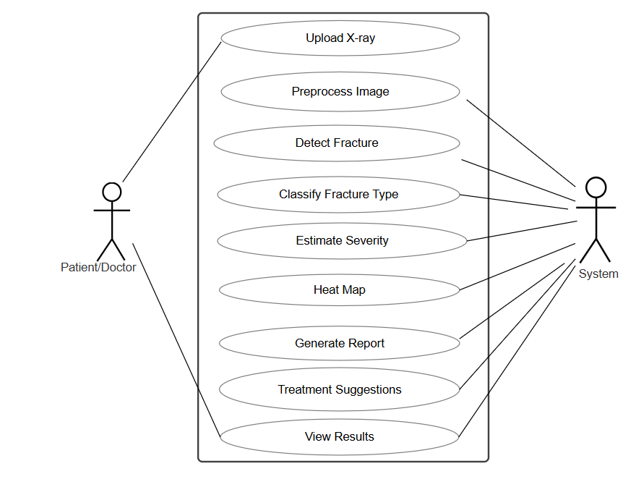
MALLA REDDY COLLEGE OF ENGINEERING AND TECHNOLOGY
Use Case Diagram:
B. Tech III Year – I Sem | Dept of Computational Intelligence| Application Development – 1 | Project Review

Slide 16
MALLA REDDY COLLEGE OF ENGINEERING AND TECHNOLOGY
The Use case diagram shows that the doctor (actor) uploads an X-ray image into the FractoScan system, which then preprocesses the image, classifies the fracture, estimates its severity, generates a heatmap, and finally provides an automated report back to the doctor for quick and accurate diagnosis. This ensures faster decision-making and reduces manual effort in fracture detection.
B. Tech III Year – I Sem | Dept of Computational Intelligence| Application Development – 1 | Project Review

Slide 17
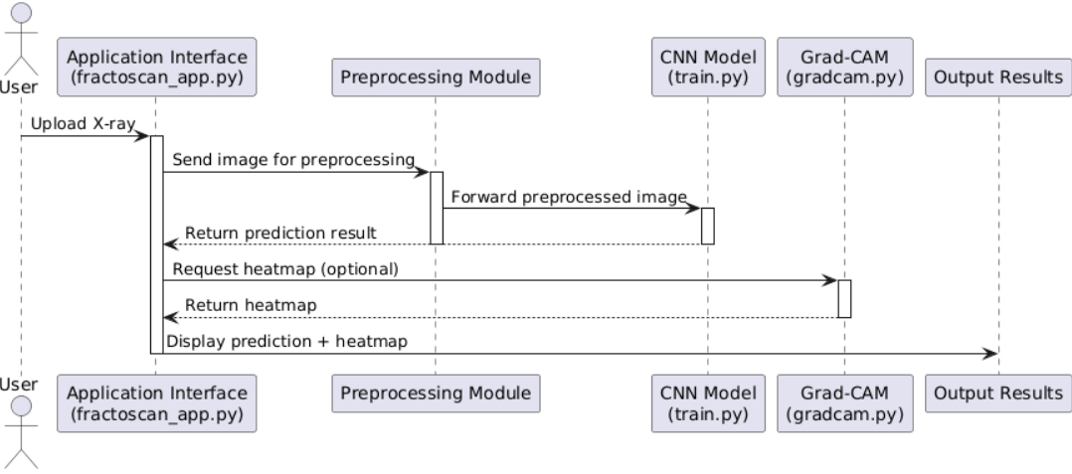
Sequence Diagram:
MALLA REDDY COLLEGE OF ENGINEERING AND TECHNOLOGY
B. Tech III Year – I Sem | Dept of Computational Intelligence| Application Development – 1 | Project Review

Slide 18
MALLA REDDY COLLEGE OF ENGINEERING AND TECHNOLOGY
The Sequence diagram shows how the doctor (actor) uploads an X-ray into the FractoScan system, after which the application sends it to the preprocessing module, then to the CNN model for fracture detection and severity estimation, followed by Grad-CAM for heatmap generation, and finally the results are returned to the doctor. This ensures a step-by-step flow of interactions between the user and system components, making the diagnosis process clear and efficient.
B. Tech III Year – I Sem | Dept of Computational Intelligence| Application Development – 1 | Project Review

Slide 19
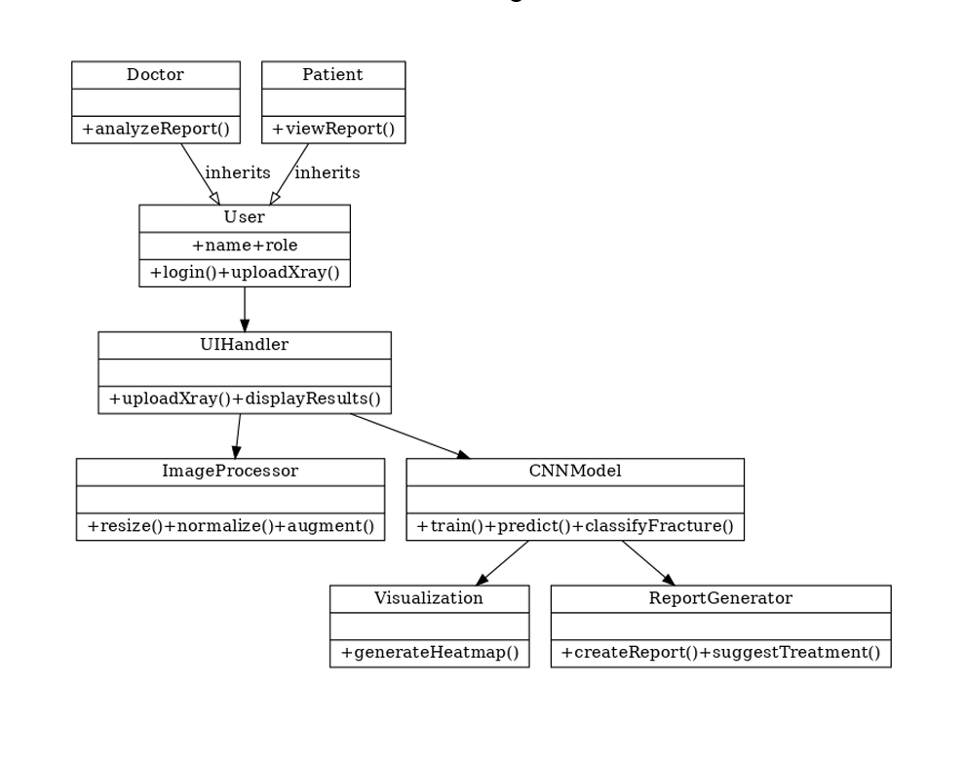
MALLA REDDY COLLEGE OF ENGINEERING AND TECHNOLOGY
Class Diagram:
B. Tech III Year – I Sem | Dept of Computational Intelligence| Application Development – 1 | Project Review

Slide 20
MALLA REDDY COLLEGE OF ENGINEERING AND TECHNOLOGY
The Class diagram shows the FractoScan system structure with classes like Preprocessing, CNNModel, GradCAM, and ReportGenerator. Each class handles a specific task, and together they connect through the FractoScanApp to provide fracture detection, heatmaps, and reports for the doctor. This design makes the system modular and easy to extend. It also improves clarity and maintenance by clearly separating responsibilities.
B. Tech III Year – I Sem | Dept of Computational Intelligence| Application Development – 1 | Project Review

Slide 21
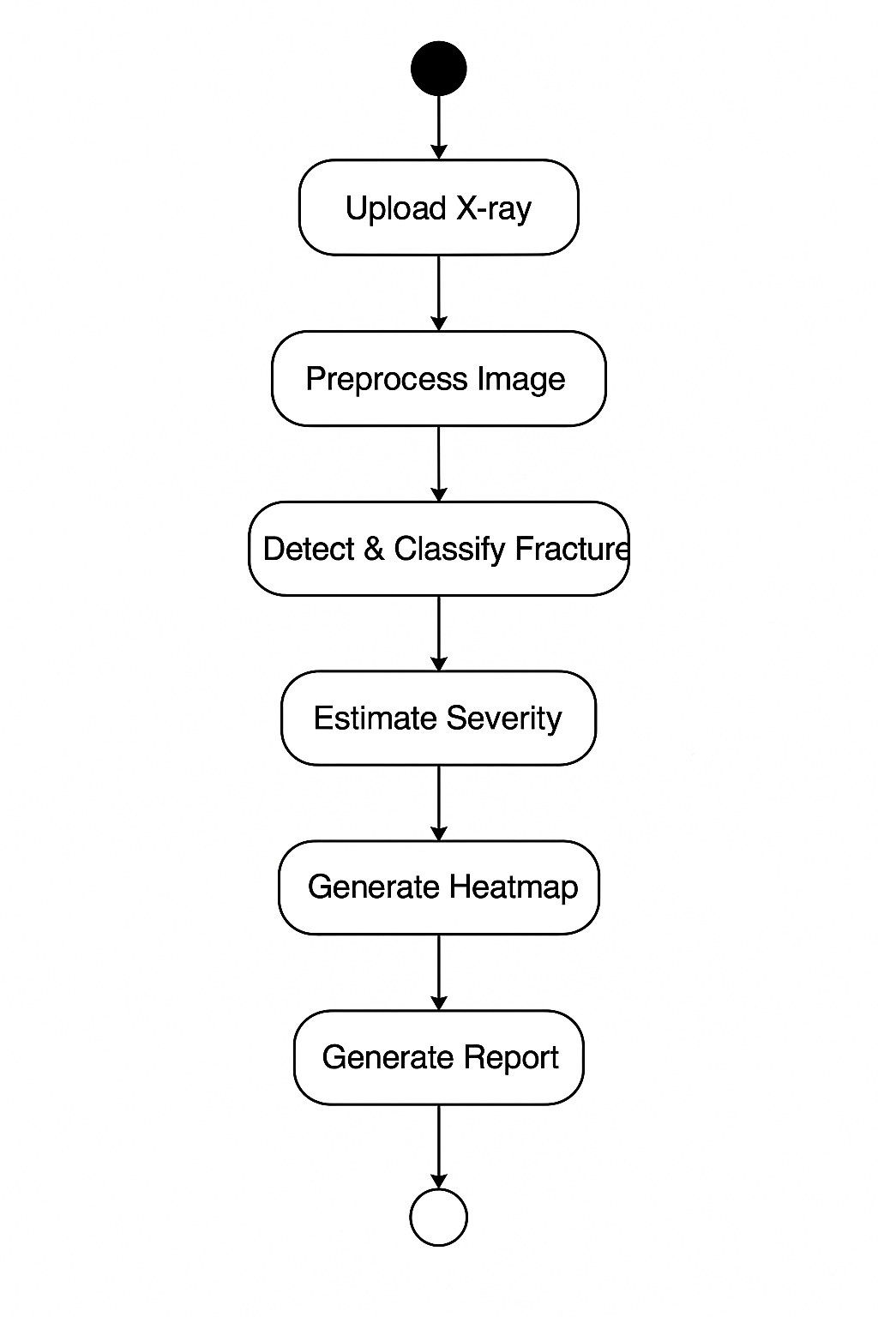
MALLA REDDY COLLEGE OF ENGINEERING AND TECHNOLOGY
Activity Diagram:
B. Tech III Year – I Sem | Dept of Computational Intelligence| Application Development – 1 | Project Review

Slide 22
MALLA REDDY COLLEGE OF ENGINEERING AND TECHNOLOGY
The Activity diagram shows the workflow of the FractoScan system step by step. It starts when the doctor uploads an X-ray image, which then goes through preprocessing for cleaning and enhancement. The processed image is sent to the CNN model for feature extraction, fracture detection, and severity classification. After that, the Grad-CAM module generates a heatmap to highlight the fractured area. Finally, the system produces an automated diagnostic report and displays the results back to the doctor. This flow ensures the process is systematic, clear, and efficient.
B. Tech III Year – I Sem | Dept of Computational Intelligence| Application Development – 1 | Project Review

Slide 23
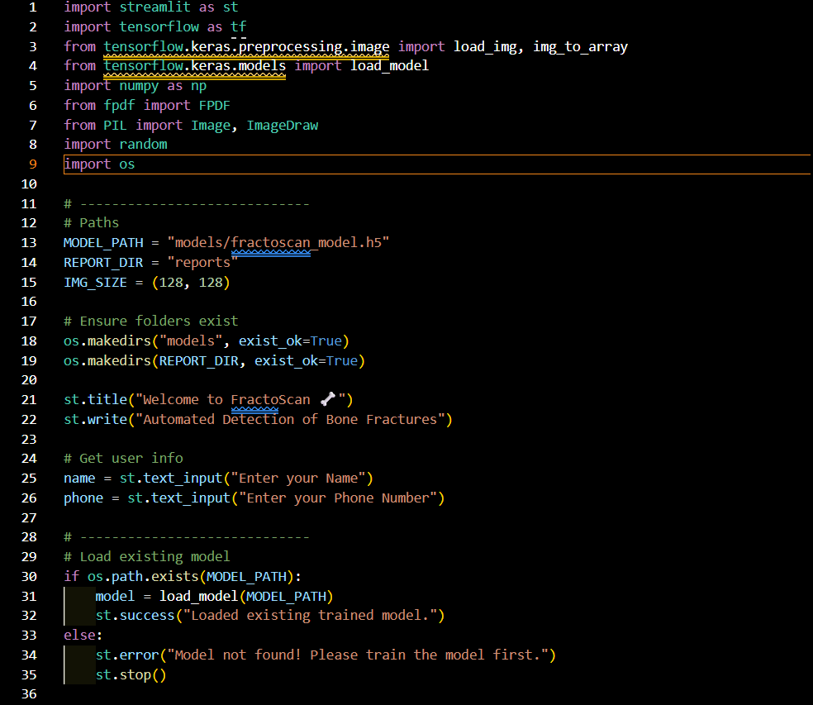
MALLA REDDY COLLEGE OF ENGINEERING AND TECHNOLOGY
Sample Code
B. Tech III Year – I Sem | Dept of Computational Intelligence| Application Development – 1 | Project Review

Slide 24
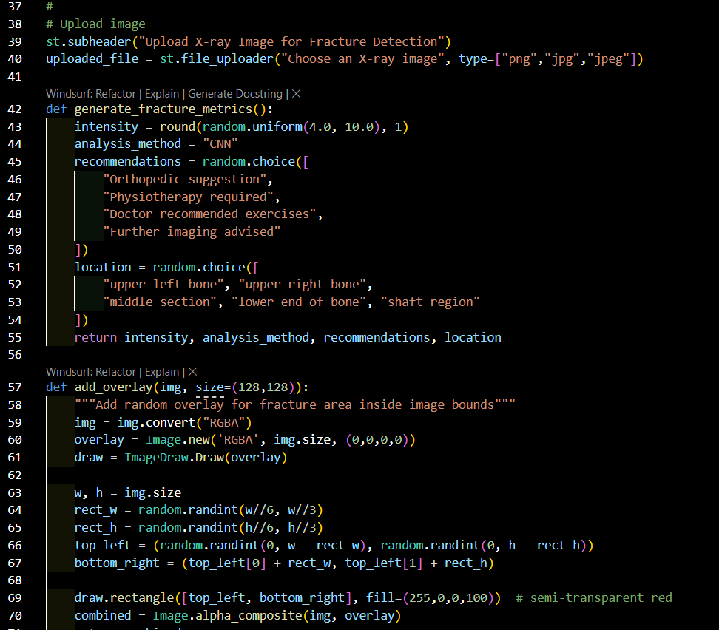
MALLA REDDY COLLEGE OF ENGINEERING AND TECHNOLOGY
B. Tech III Year – I Sem | Dept of Computational Intelligence| Application Development – 1 | Project Review

Slide 25
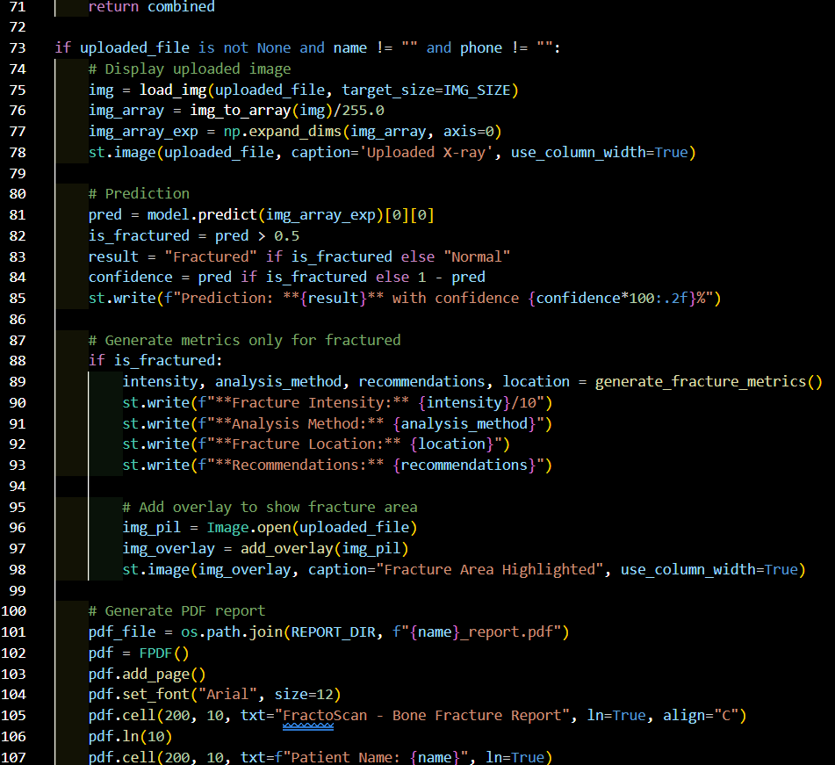
MALLA REDDY COLLEGE OF ENGINEERING AND TECHNOLOGY
B. Tech III Year – I Sem | Dept of Computational Intelligence| Application Development – 1 | Project Review

Slide 26
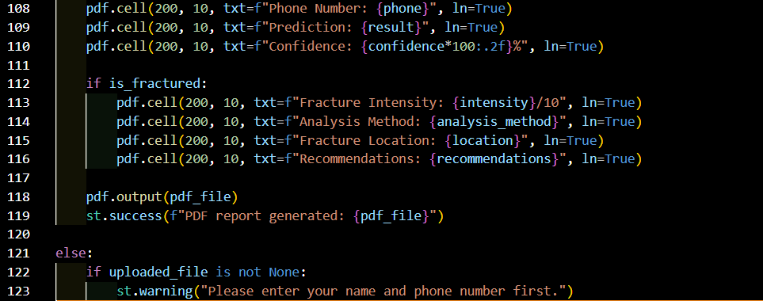
MALLA REDDY COLLEGE OF ENGINEERING AND TECHNOLOGY
B. Tech III Year – I Sem | Dept of Computational Intelligence| Application Development – 1 | Project Review

Slide 27
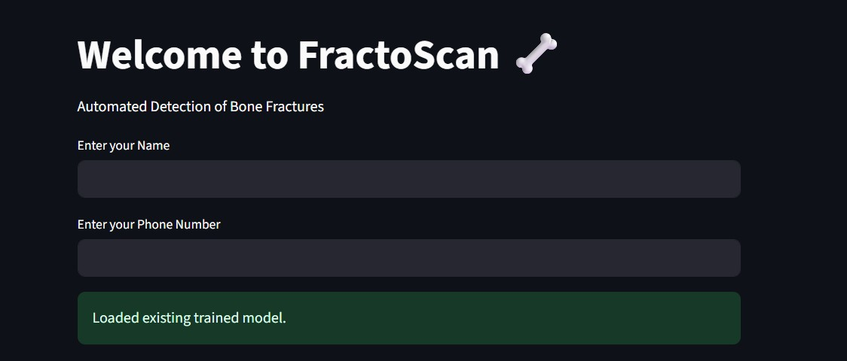
MALLA REDDY COLLEGE OF ENGINEERING AND TECHNOLOGY
Output Screenshots
B. Tech III Year – I Sem | Dept of Computational Intelligence| Application Development – 1 | Project Review

Slide 28
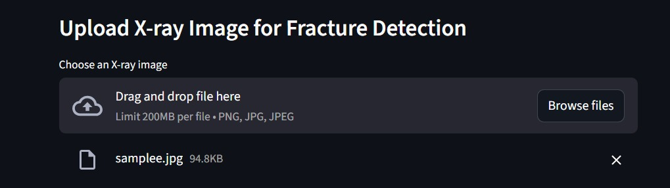
MALLA REDDY COLLEGE OF ENGINEERING AND TECHNOLOGY
B. Tech III Year – I Sem | Dept of Computational Intelligence| Application Development – 1 | Project Review

Slide 29
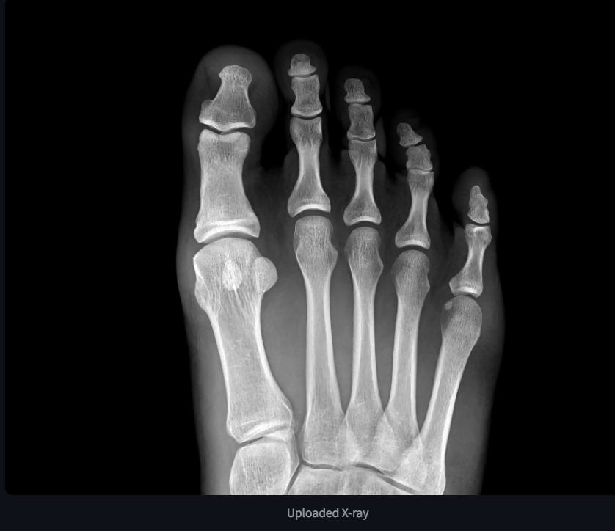
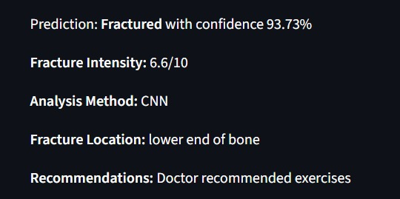
MALLA REDDY COLLEGE OF ENGINEERING AND TECHNOLOGY

Slide 30
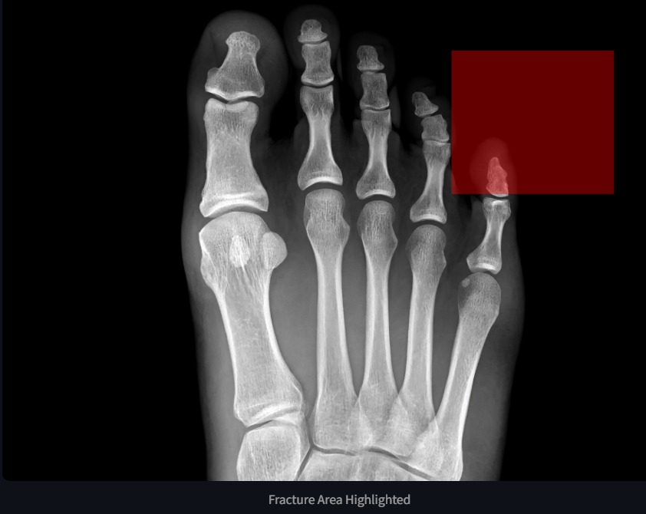
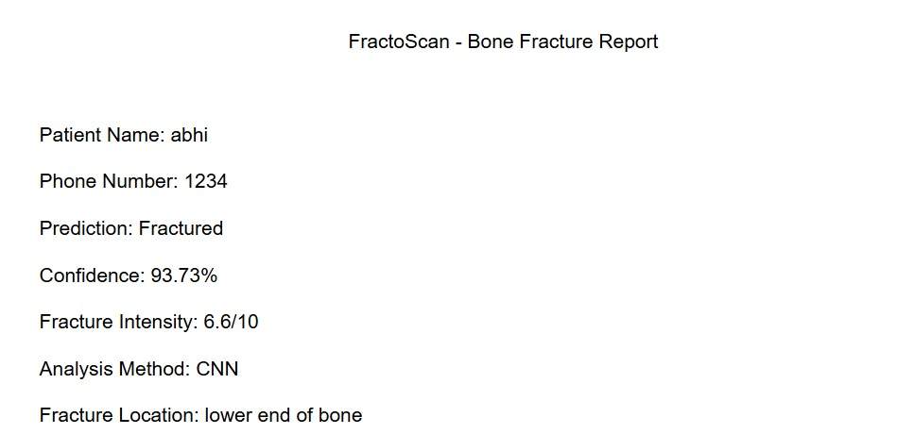
MALLA REDDY COLLEGE OF ENGINEERING AND TECHNOLOGY
B. Tech III Year – I Sem | Dept of Computational Intelligence| Application Development – 1 | Project Review

Slide 31
MALLA REDDY COLLEGE OF ENGINEERING AND TECHNOLOGY
References
Rajpurkar, P., Irvin, J., Bagul, A., Ding, D., Duan, T., Mehta, H., ... & Ng, A. Y. (2017).
MURA: Large Dataset for Abnormality Detection in Musculoskeletal Radiographs.arXiv preprint arXiv:1712.06957.
🔗 https://arxiv.org/abs/1712.06957
DevBatrax (2022).Fracture Detection Using X-Ray Images (Dataset).
Kaggle.
🔗 https://www.kaggle.com/datasets/devbatrax/fracture-detection-using-x-ray-images
B. Tech III Year – I Sem | Dept of Computational Intelligence| Application Development – 1 | Project Review

Slide 32
MALLA REDDY COLLEGE OF ENGINEERING AND TECHNOLOGY
Future Enhancements:
Expand the dataset size to improve accuracy across diverse fracture types.
Train deeper CNN architectures for higher performance.
Add multi-class classification for different fracture categories and severities.
Integrate real-time X-ray capture and prediction in hospitals.
B. Tech III Year – I Sem | Dept of Computational Intelligence| Application Development – 1 | Project Review

Slide 33
MALLA REDDY COLLEGE OF ENGINEERING AND TECHNOLOGY
Conclusion:
The project demonstrates an effective approach for automating bone fracture detection and classification using Convolutional Neural Networks. By applying preprocessing techniques to enhance image quality and utilizing CNNs for feature learning, the system achieves reliable and accurate predictions. The inclusion of Grad-CAM visualization makes the results more interpretable by highlighting fracture regions, while the Streamlit-based interface provides an easy-to-use platform for uploading X-rays and viewing outcomes. Overall, the system reduces manual effort, speeds up diagnosis, and supports doctors in making quicker and more informed decisions, proving its value as a practical decision-support tool in orthopedic care.
B. Tech III Year – I Sem | Dept of Computational Intelligence| Application Development – 1 | Project Review

Slide 34
Thank you
MALLA REDDY COLLEGE OF ENGINEERING AND TECHNOLOGY
B. Tech III Year – I Sem | Dept of Computational Intelligence| Application Development – 1 | Project Review

